Slide 2
What role does fasting play in our lives today?

Slide 3
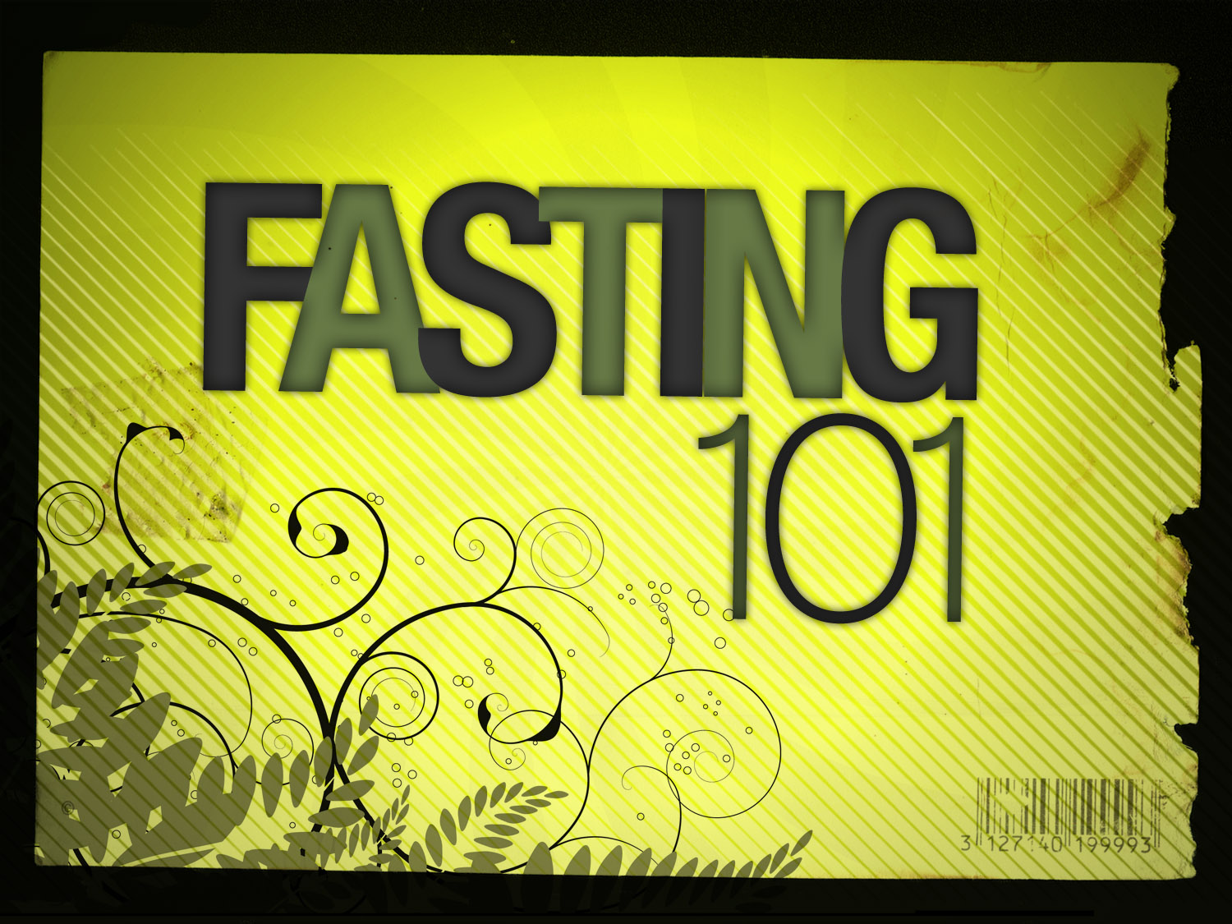

Slide 4
Biblical Facts on Fasting:
Fasting was an expected discipline in both the Old and New Testament eras.
Fasting and prayer can restore the loss of the “first love” for your Lord and result in a more intimate relationship with Christ.
Fasting is a biblical way to truly humble yourself in the sight of God (Psalm 35:13; Ezra 8:21). King David said, "I humble myself through fasting."

Slide 5
Fasting aids the Holy Spirit in revealing your true spiritual condition, resulting in brokenness, repentance, and a transformed life.
The Holy Spirit will quicken the Word of God in your heart and His truth will become more meaningful to you!
Fasting can transform your prayer life into a richer and more personal experience.

Slide 6
Fasting can result in a dynamic personal revival in your own life-and make you a channel of revival to others.
Fasting and prayer are the only disciplines that fulfill the requirements of II Chron. 7:14:
“If my people, who are called by my name, will humble themselves and pray and seek my face and turn from their wicked ways, then will I hear from heaven and will forgive their sin and will heal their land.”

Slide 7
The Bible describes fasting as a natural way for God’s people individually or corporately to express,
Sorrow
Repentance
Humility
Seriousness in Prayer
A Desire for God’s Presence

Slide 8
¹⁸ Once when John’s disciples and the Pharisees were fasting, some people came to Jesus and asked, “Why don’t your disciples fast like John’s disciples and the Pharisees do?”

Slide 9
¹⁹ Jesus replied, “Do wedding guests fast while celebrating with the groom? Of course not. They can’t fast while the groom is with them.

Slide 10
²⁰ But someday the groom will be taken away from them, and then they will fast.

Slide 11
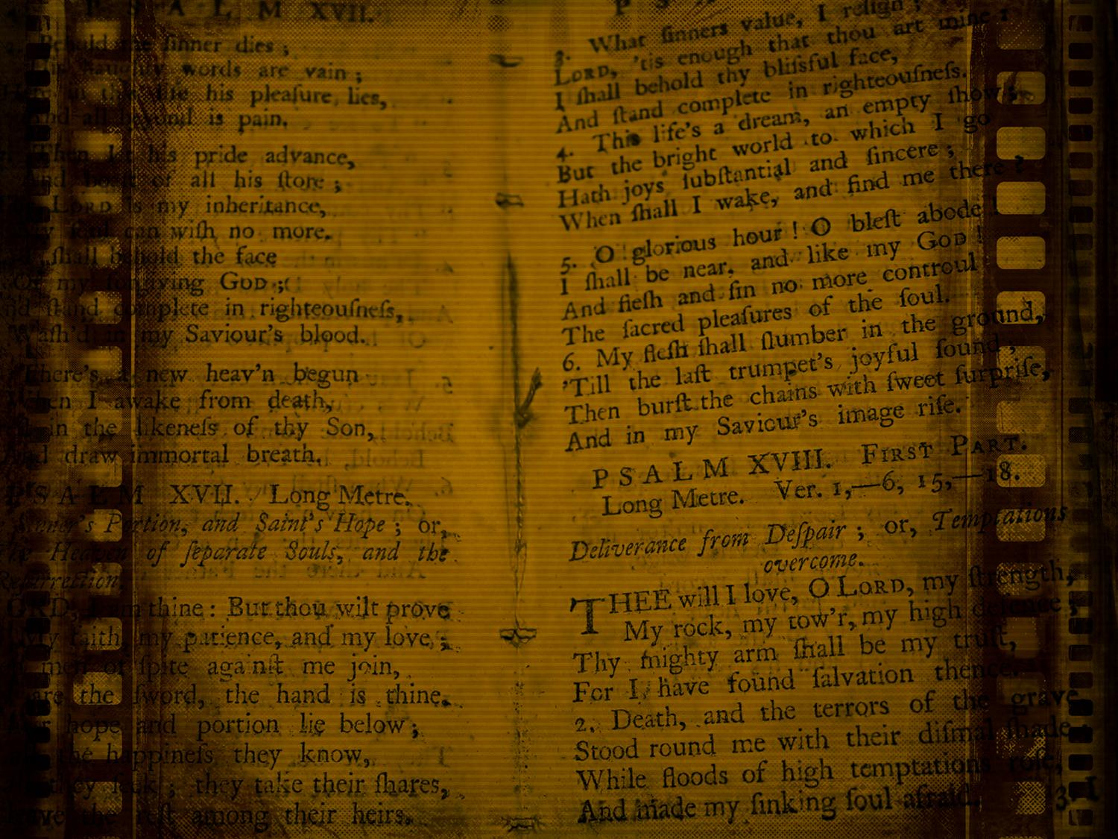
“And when you fast, don’t make it obvious, as the hypocrites do, for they try to look miserable and disheveled so people will admire them for their fasting. I tell you the truth, that is the only reward they will ever get.

Slide 12
¹⁷ But when you fast, comb your hair and wash your face. ¹⁸ Then no one will notice that you are fasting, except your Father, who knows what you do in private. And your Father, who sees everything, will reward you.”
– Matthew 6:16–18 (NLT)

Slide 13
Proper Motives for Biblical Fasting
I. As a Sign of Sorrow
A. For tragic events (Judg. 20:26; 1 Sam. 31:13 = 1 Chron. 10:12; 2 Sam. 1:12; 3:35; Esth. 4:3; Jer. 14:1–12; Joel 1:14; 2:12–15)
B. For personal sorrow (1 Sam. 1:7–8; 20:34; Job 3:24; Pss. 42:3; 102:4; 107:17–18)

Slide 14
Proper Motives for Biblical Fasting
I. As a Sign of Sorrow
II. As a Sign of Repentance and Seeking Forgiveness
A. National or corporate sins (Exod. 34:28; Ezra 9:1–10:17; Neh. 1:4–7; 9:1; Dan. 9:3–14; Jon. 3:5–9; Zech. 8:16–19)
B. Personal sins (2 Sam. 12:16–23; 1 Kings 21:27–29; Ps. 69:10; Acts 9:9[?])
C. As an opportunity to publicly expose sin (1 Kings 21:9–12; Isa. 58:1–5; Jer. 36)

Slide 16
“Examine yourselves to see whether you are in the faith; test yourselves. Do you not realize that Christ Jesus is in you—unless, of course, you fail the test?”
– 2 Corinthians 13:5

Slide 17
Have a
GREAT Week

